Slide 1
Introduction: Sprint-Review
Purpose: Transparency, Inspection & Adaption
Sharing project status
Sharing lessons learned
Space to gather and give feedback
Align perspectives: developers, QAs & stakeholders
Target Audiences
Stakeholder
Development team
QA

Slide 2


Sprint Review from 2024-01-02 to 2024-01-16
Agenda:
Project Status
AR / Prefab Wall / Prefab Column / Geoso, Khiem, 15min
Construction, Steel and QA Status, Minh, 15min
Rebar Nesting, Vasilii, 10 min
GSI’s Odoo Topics, Thao, Huy, 10 min
Weekly DEV-Team-Schedule report from Odoo Timesheets as an end-2-end prototype for GSI's Automation Hub, Tuyen, Thai, LA, 15min
R&D: Automated Labelling, Tai, 10 min
Knowledge Sharing
Daily usage tools Cryptography basis, Vasilii, 15 min
Live Share Extension, Tuyen, 5 min
Semantic Versioning, Thai, 5 min

Slide 3
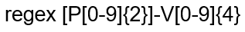
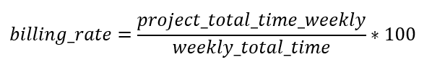
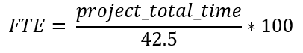
Weekly DEV-Team-Schedule report from Odoo Timesheets
Fixed errors & updating code
Fixed errors:
Billing rate according to billable project.
Formula of FTE (fulltime equivalent) each project.

Slide 4
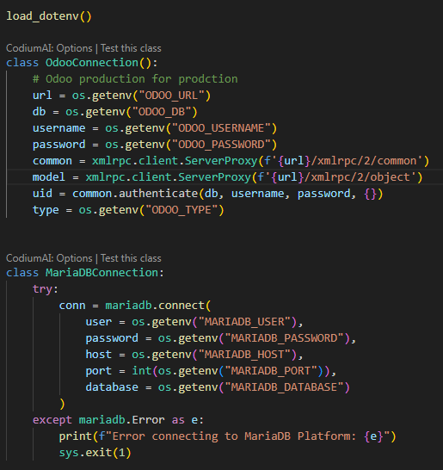
Weekly DEV-Team-Schedule report from Odoo Timesheets
Updating code:
Connect and get data from Odoo Production.
Hiding connection’s credentials in code.
5 new APIs & updating 16 APIs.
Create new view for FTE by each department.

Slide 5
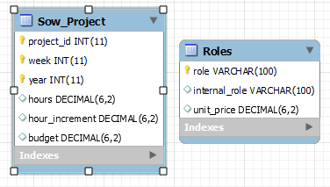
Weekly DEV-Team-Schedule report from Odoo Timesheets
SOW report:
Use case: Calculating and statistic budget for each project.
Database:
2 tables Roles & Sow_Project
2 views SOW Increment report & SOW budget report
4 APIs:
GET - /sow_report/
GET - /roles_list/
PUT - /roles/
PUT - /role/

Slide 6
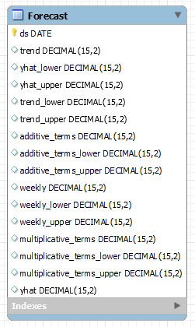
Weekly DEV-Team-Schedule report from Odoo Timesheets
Forecast:
Use case: Prediction budget of each project for future and comparation budgets.
Database:
Table Forecast
APIs:
POST - /forecast/

Slide 7
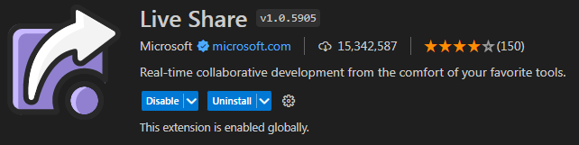
Live Share Extension
What’s is Live Share?
Allowing users coding and debugging with their collaborators in real time.
An extension in Visual Studio Code, v1.0.5905

Slide 8
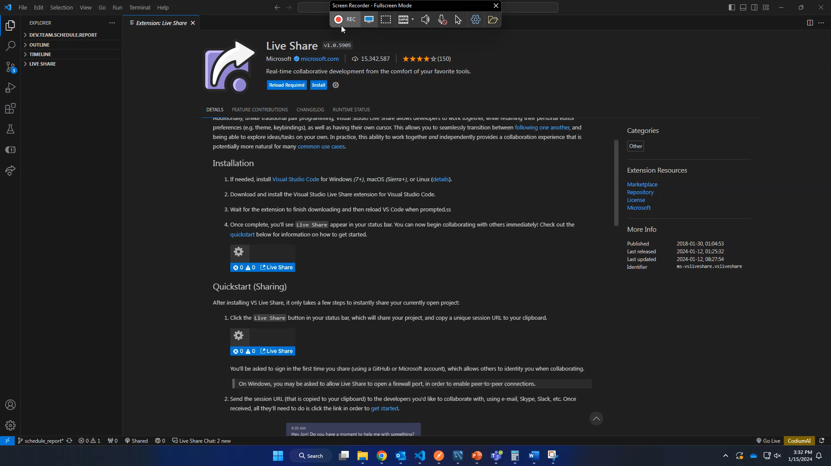

Slide 9
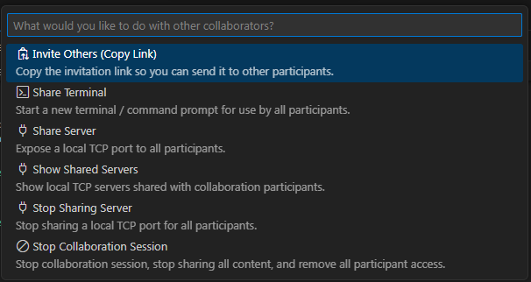
Live Share Extension
Sharing
Click Live Share in status bar, copy link.
Send link to collaborators.
Accepting collaborators.

Slide 10
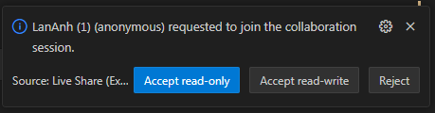
Live Share Extension
Joining
Click shared link.
Sign in (Github, Microsoft Account or Anonymous).
Waiting the acception.

Slide 11
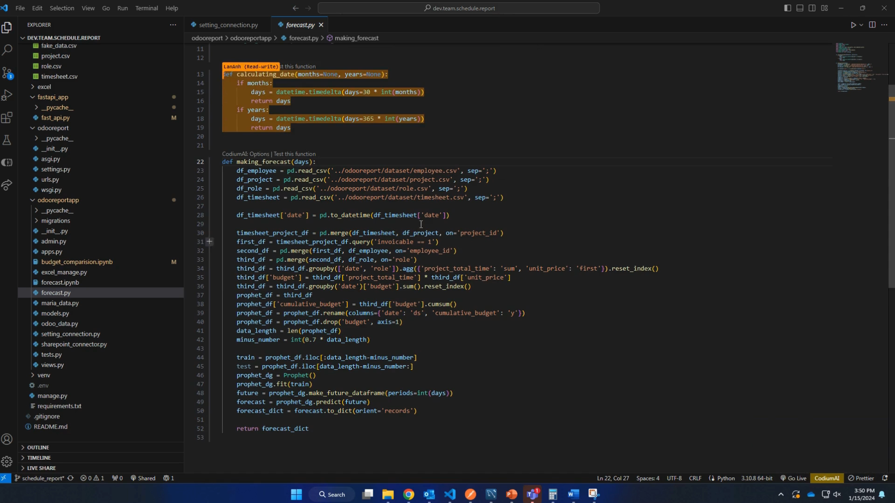

Slide 12
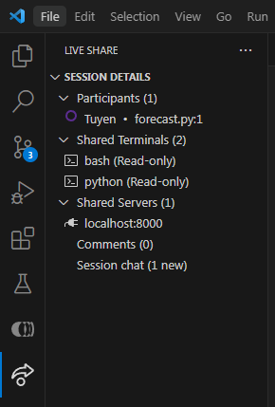
Live Share Extension
What is it advantages?
Fast & easy sharing and joining.
Development together, adding discussion.
Supporting many languages and frameworks.
Sharing terminal and web localhost, server.
Independence personal preferences (theme, keybinding)
Know exactly who joining, where they code, what they code.
Q&A

